Slide 1
IT 1107 Mathematics for IT
Week 7 - Matrices

Slide 2
Matrix
Matrix is a rectangular array of numbers arranged in rows & columns
The individual items in a matrix are called entries or elements
Eg: 1 9 6
20 5 -6
This is a matrix with 2 rows & 3 columns

Slide 3

m by n matrix
There are m rows and n rows in this matrix

Slide 4
Square Matrix
Matrix with same number of rows and columns is called a square matrix
Eg: 2x2 , 3x3 , 4x4 and 5x5 matrices
The diagonal elements of a square matrix are those elements where the row and column index are same.

Slide 5
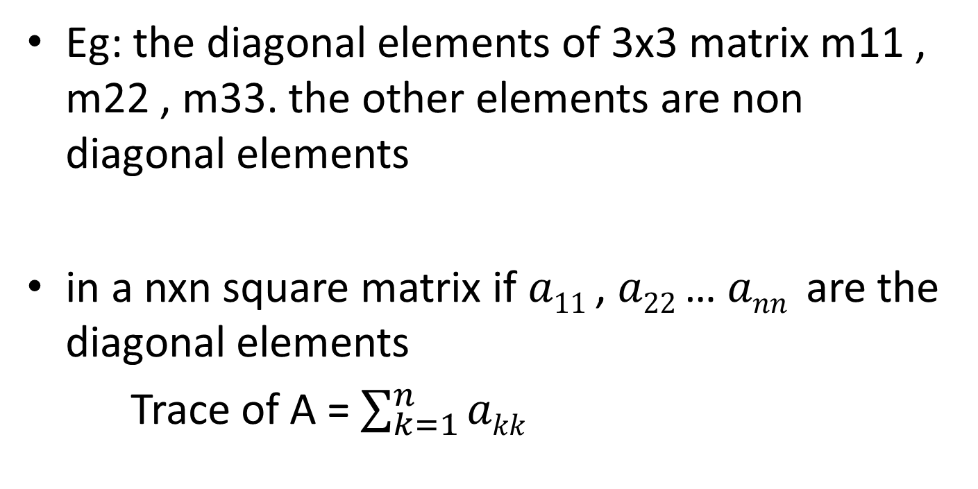
Eg: the diagonal elements of 3x3 matrix m11 , m22 , m33. the other elements are non diagonal elements
in a nxn square matrix if $a11$, $a22$… $ann$ are the diagonal elements
Trace of A = $\sum_{k=1}^{n}{akk}$

Slide 6
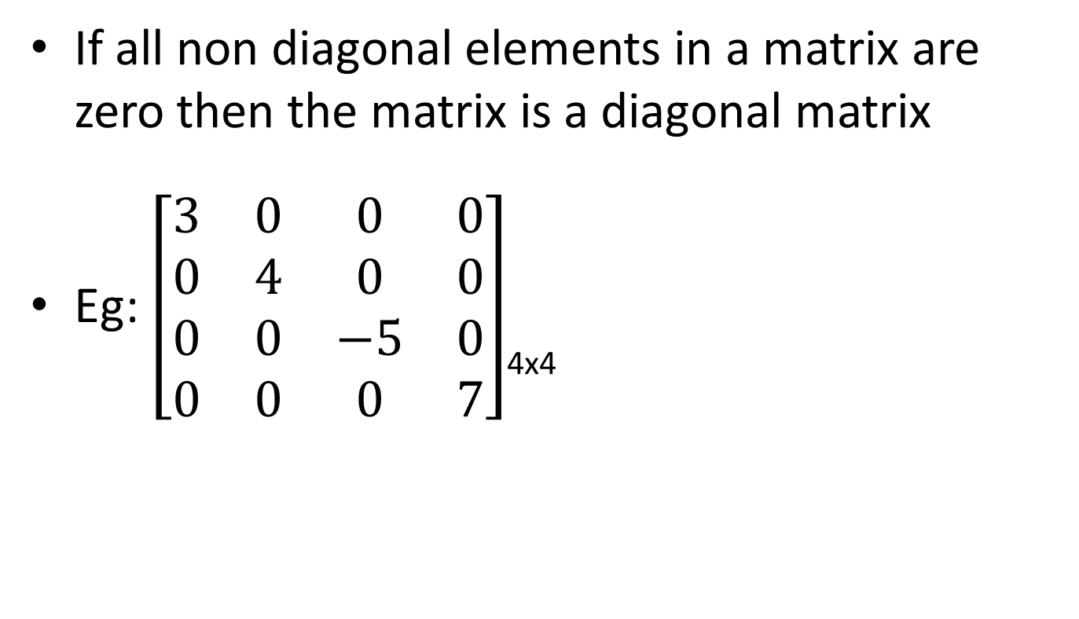
Diagonal Matrix
If all non diagonal elements in a matrix are zero then the matrix is a diagonal matrix
Eg: $\left[\begin{matrix}3 & 0 & 0 & 0 \\ 0 & 4 & 0 & 0 \\ 0 & 0 & −5 & 0 \\ 0 & 0 & 0 & 7\end{matrix}\right]$_{4x4}

Slide 7
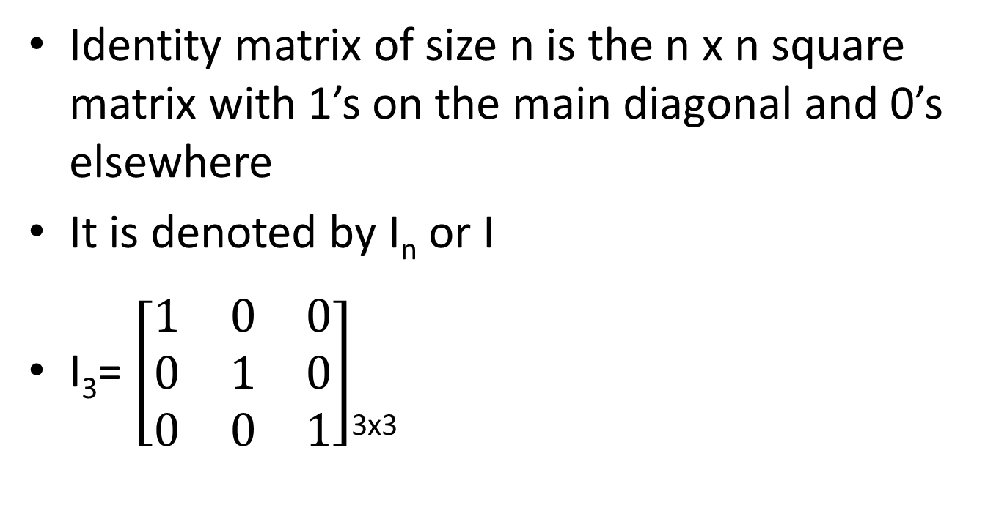
Identity Matrix
Identity matrix of size n is the n x n square matrix with 1’s on the main diagonal and 0’s elsewhere
It is denoted by I_{n} or I
I₃= $\left[\begin{matrix}1 & 0 & 0 \\ 0 & 1 & 0 \\ 0 & 0 & 1\end{matrix}\right]$_{3x3}

Slide 8
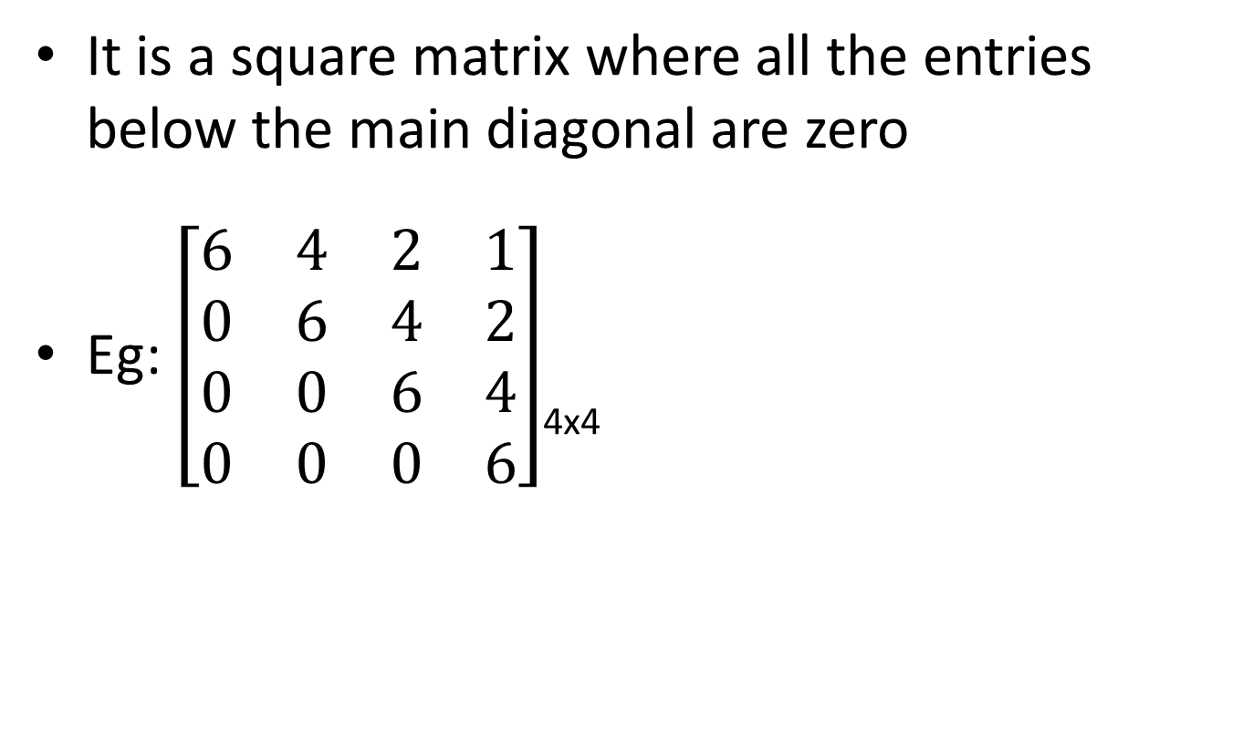
Upper Triangular Matrix
It is a square matrix where all the entries below the main diagonal are zero
Eg: $\left[\begin{matrix}6 & 4 & 2 & 1 \\ 0 & 6 & 4 & 2 \\ 0 & 0 & 6 & 4 \\ 0 & 0 & 0 & 6\end{matrix}\right]$_{4x4}

Slide 9
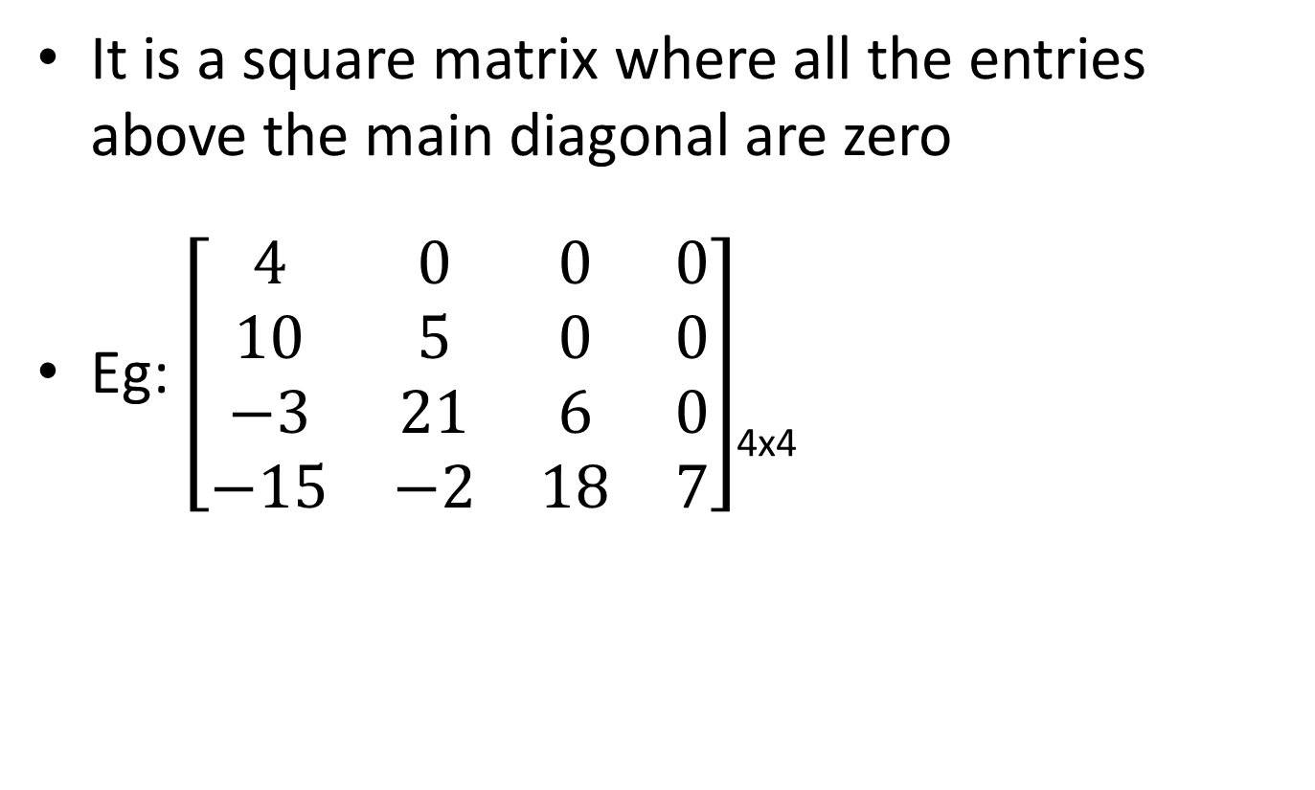
Lower Triangular Matrix
It is a square matrix where all the entries above the main diagonal are zero
Eg: $\left[\begin{matrix}4 & 0 & 0 & 0 \\ 10 & 5 & 0 & 0 \\ −3 & 21 & 6 & 0 \\ −15 & −2 & 18 & 7\end{matrix}\right]$_{4x4}

Slide 10
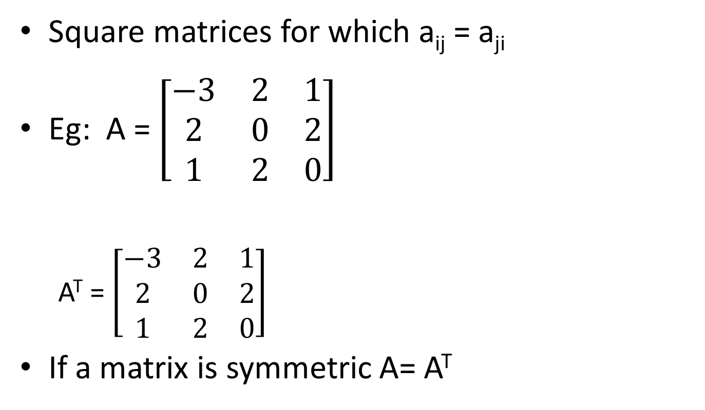
Symmetric Matrix
Square matrices for which a_{ij} = a_{ji}
Eg: A = $\left[\begin{matrix}−3 & 2 & 1 \\ 2 & 0 & 2 \\ 1 & 2 & 0\end{matrix}\right]$
A^{T} = $\left[\begin{matrix}−3 & 2 & 1 \\ 2 & 0 & 2 \\ 1 & 2 & 0\end{matrix}\right]$
If a matrix is symmetric A= A^{T}

Slide 11
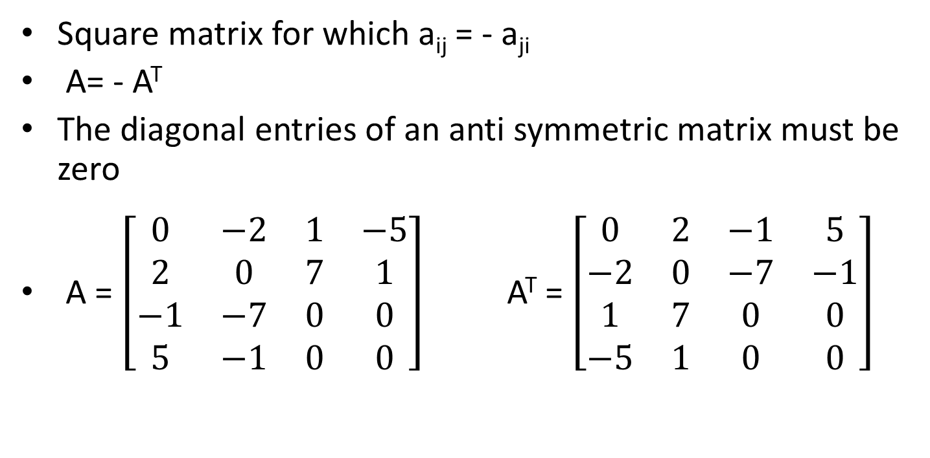
Anti Symmetric Matrix/skew symmetric
Square matrix for which a_{ij} = - a_{ji}
A= - A^{T}
The diagonal entries of an anti symmetric matrix must be zero
A = $\left[\begin{matrix}0 & −2 & 1 & −5 \\ 2 & 0 & 7 & 1 \\ −1 & −7 & 0 & 0 \\ 5 & −1 & 0 & 0\end{matrix}\right]$ A^{T} = $\left[\begin{matrix}0 & 2 & −1 & 5 \\ −2 & 0 & −7 & −1 \\ 1 & 7 & 0 & 0 \\ −5 & 1 & 0 & 0\end{matrix}\right]$

